Slide 1
object oriented paradigm
invention management system

Slide 2
group 10
S Abhishek
Rahan Manoj
Harsha Sathish
Arvind Kumar

Slide 3
Welcome, All!

Slide 4
USE CASE DIAGRAM
UML / CLASS DIAGRAM
ASSOCIATION
REALIZATION
Concepts Used
GENERALIZATION
DEPENDENCY
AGGREGATION
COMPOSITION
JDBC
SWING

Slide 5
Invention Details
Inventor Details
Invention Management System
Award Details
Jury Details
Panel Details
Nominations

Slide 6
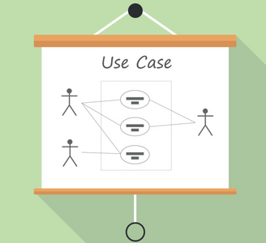
USE CASE

Slide 7
Use case diagram gives a graphic overview of the actors and different functions needed by those actors and how these different functions interact.
It is the easiest method to find out the main actors involved and the main process.
This use case diagram depicts the high level view of invention management system.
It also provides the scenarios in which the application interacts with,
INVENTOR
JURY
ADMIN

Slide 8
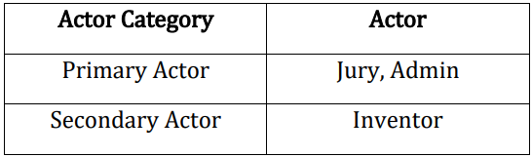
There are total of Twenty-Six use cases that represent the specific functionality of Invention Management System.
Each actor interacts with a particular use case.

Slide 9
ADMIN
Login to take the overall control of the Data Base.
Add or remove Awards.
Add or remove Panel.
Add or remove Jury.
Declare Nominations.
Declare Results.
Admin takes the overall control of the data base or in other words say one of the primary actors.

Slide 10
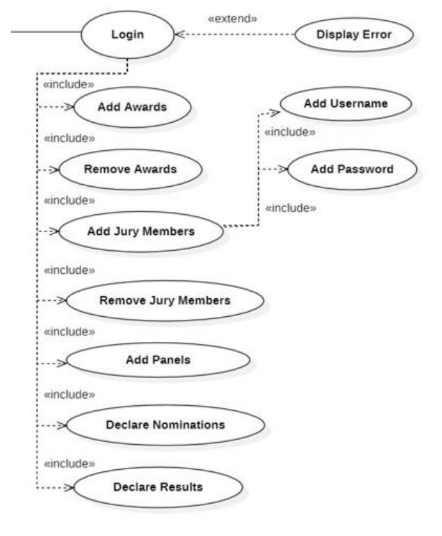

Slide 11
inventor
Register in the database to create Account by entering New username and passwords.
Then login using credentials and add the details of the invention.
View the invention details , Awards , Nominations , Results.
Inventor can create the account in the database to register the inventions.
Succesfully after registered and login we get the option to add invention to the data base.
Inventor can also see the invention details thathave enclosed while registered in the data base.
Inventor also can view the results of invention.

Slide 12
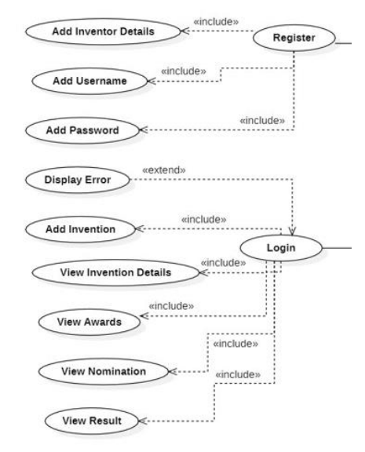

Slide 13
jury
First login to the invention management system and view the details.
Then select the required invention.
Award marks for selected Invention.
Once they successfully login by using credentials they can view all inventions.
Then after they can select the aloted invention and award marks

Slide 14
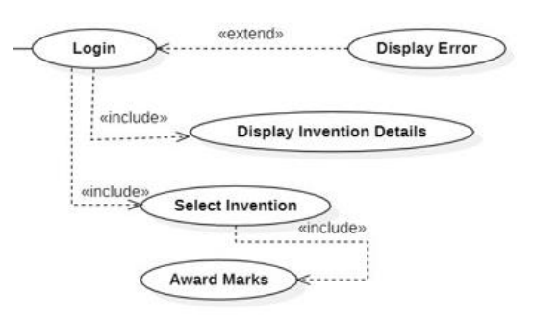

Slide 15
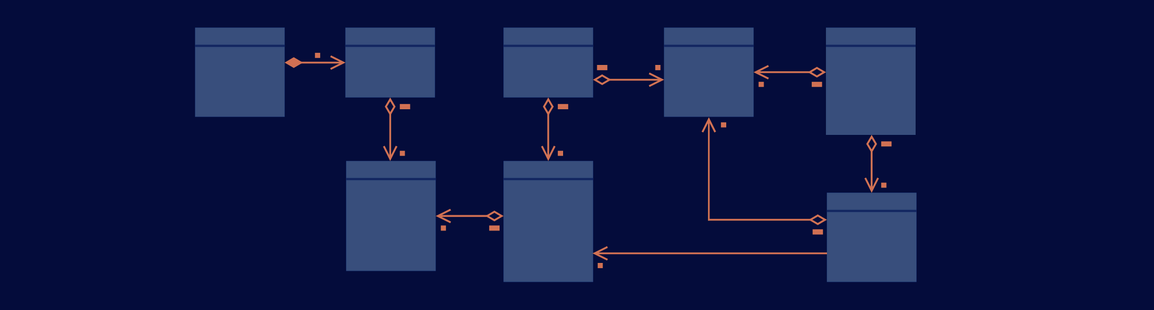
Class Diagram

Slide 16
Class diagrams are the main buildings block of any object oriented solution.
It shows the classes in a system , attributes , and operations of each class and the relationship between each class.
In most modeling tools, a class has three parts :
Name - at the top
Attributes - in the middle
operations - at the bottom
In a large system with many related classes, classes are grouped together to create class diagrams.

Slide 17
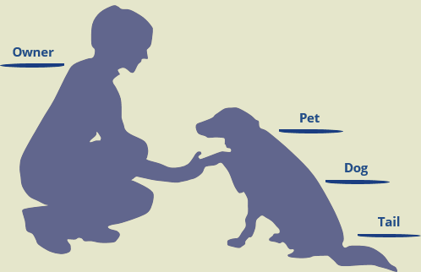
Association

Slide 18
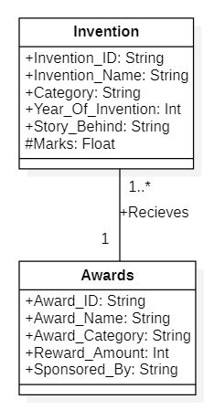
If two classes in a model need to communicate with each other, there must be a link between them, and that can be represented by an association.
Association can be represented by a line between these classes with an arrow indicating the navigation direction.
We can indicate the multiplicity of an association by adding multiplicity adornments to the line denoting the association.

Slide 19
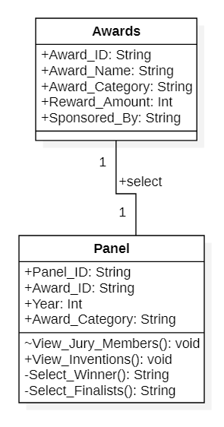
Association establishes a relationship between two separate classes Invention and Awards through their objects.
Both the classes represent two separate entities.
One Award can be given to one or more Invention.
Panel selects only one winner for a
particular Award.
One Award can be selected by only
One Panel.

Slide 20
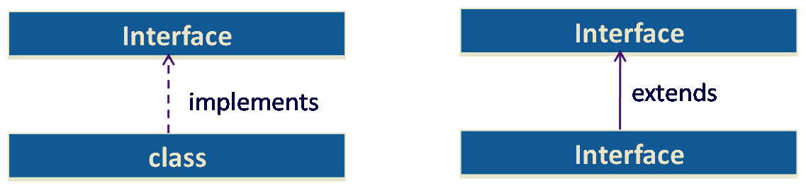
Realization

Slide 21
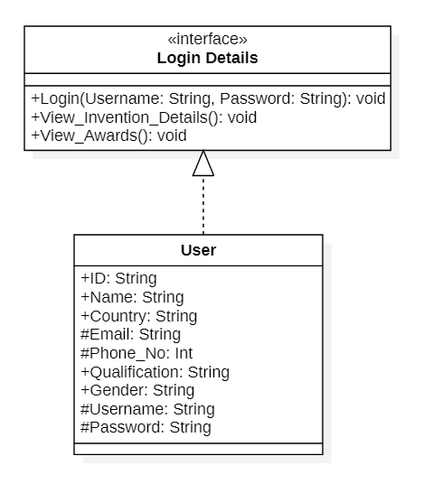
An interface in java is a blueprint of a class. It has static constants and abstract methods only.
The interface in java is a mechanism to achieve full abstraction.
There can be only abstract methods in the java interface, not the method body.
It is used to achieve full abstraction and multiple inheritance in Java.
User implements an interface Login Details, thereby inheriting the abstract methods of the Login details.

Slide 22

Generalization

Slide 23
A generalization is a bottom-up approach in which two lower-level entities combine to form a higher-level entity.
In generalization, the higher-level entity can also combine with other lower-level entities to make further higher-level entities.
Generalization comes into the picture when there are certain classes that have common properties in them.
These common properties are then put in a separate class and made a generic class, from which specific classes are derived.
Then there exists an IS-A relation between subclass and parent class.
Admin Inherits the properties of the User.
Inventor Inherits the properties of User.
Jury Member Inherits the properties of User.

Slide 24
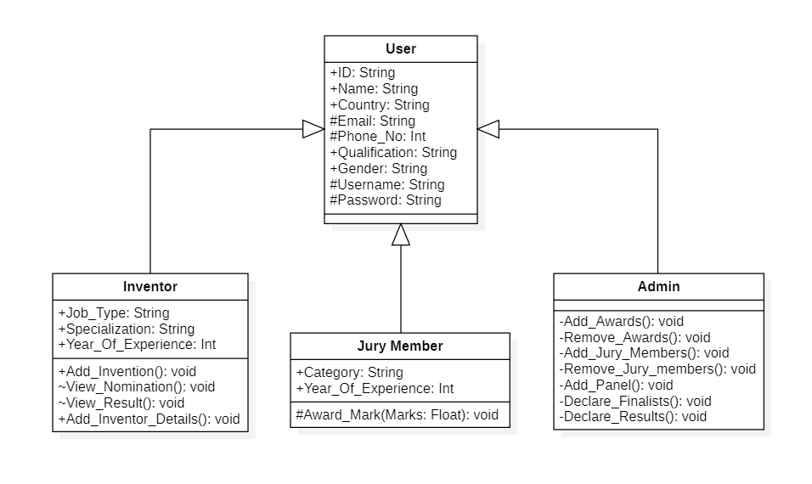

Slide 25

Dependency

Slide 26
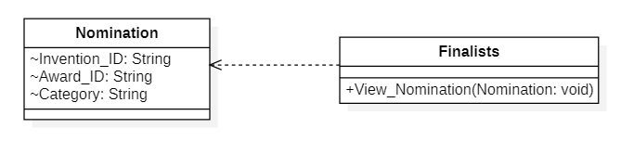
A Java class has a dependency on another class if it uses an instance of this class.
We call this a class dependency.
One class depends on another means if something change in one, it requires to check the other in sense of any change in accordance.
Finalists Dependent on the Nominations since an object of Nominations are being used by the Finalists.

Slide 27
AGGREGATION

Slide 28
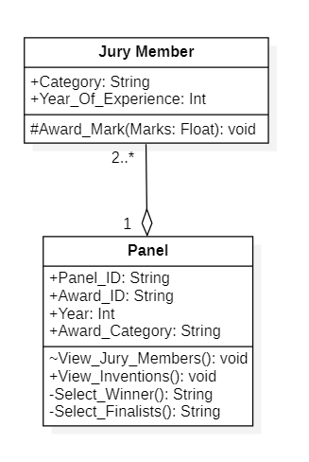
Aggregation is a “part of” or other word “has a" association relationship
Aggregation is more specific than an ordinary association.
It is an association that represents a part-whole or part-of relationship.
The Jury Member can exist independently of the Panel.

Slide 29
COMPOSITION

Slide 30
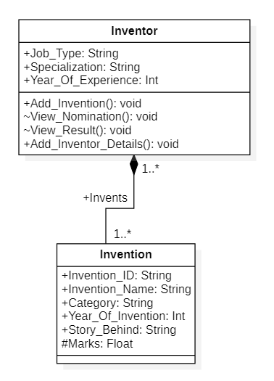
The composition is a stronger sort of the "part of "has a” association relationship
The composition is more specific than aggregation.
The composition has a strong dependency between instances of the container class and instances of the contained class.
If the container is destroyed, it means every instance that it contains is destroyed as well.
The invention cannot exist without the Inventor.

Slide 31
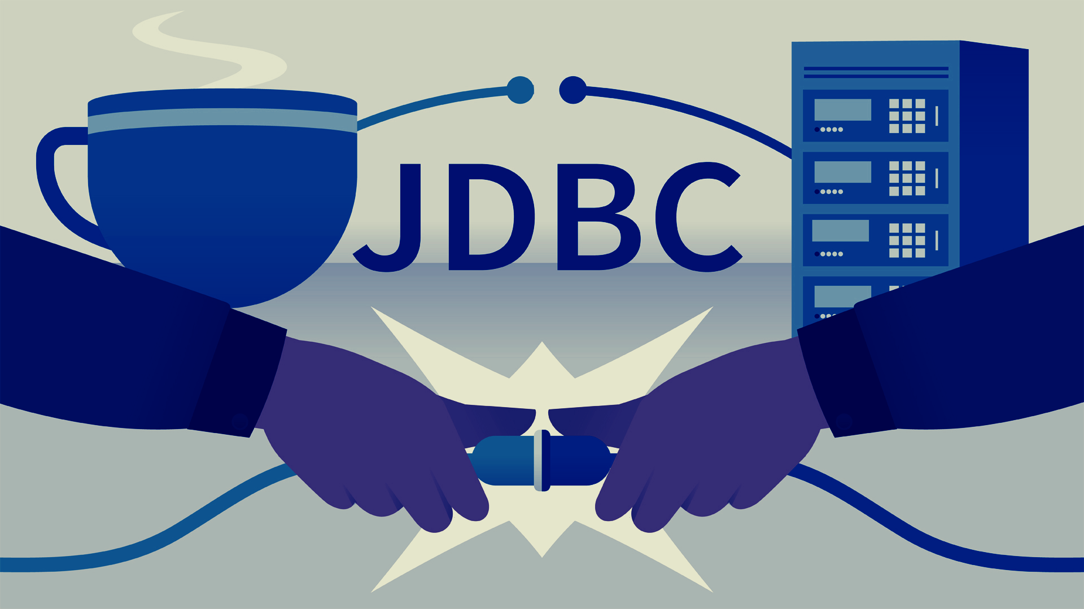

Slide 32
JDBC stands for Java Database Connectivity, which is a standard Java API for database-independent connectivity between the Java programming language and a wide range of databases.
The JDBC library includes APIs for each of the tasks mentioned below that are commonly associated with database usage.
Making a connection to a database.
Creating SQL statements.
Executing SQL queries in the database.
Viewing & Modifying the resulting records.

Slide 33
Swing

Slide 34
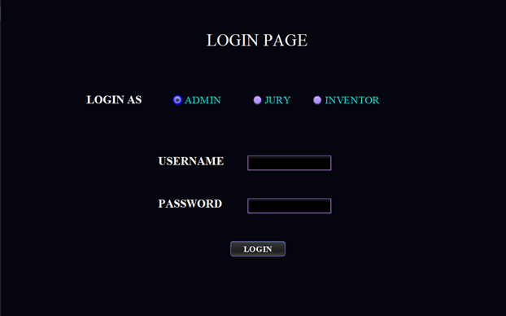
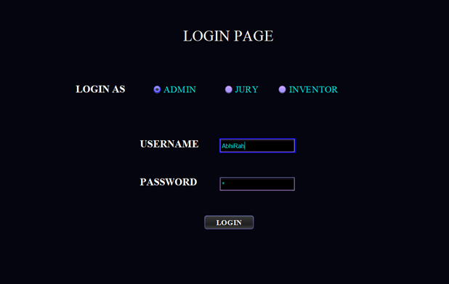

Slide 35
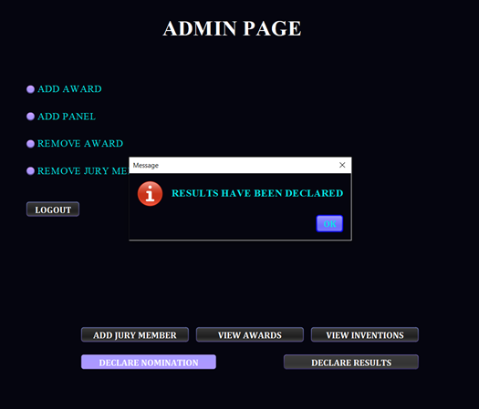

Slide 36
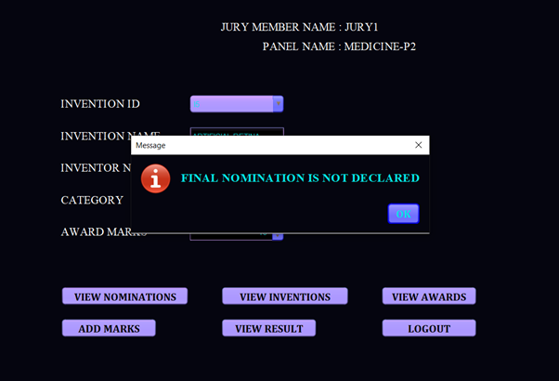

Slide 37
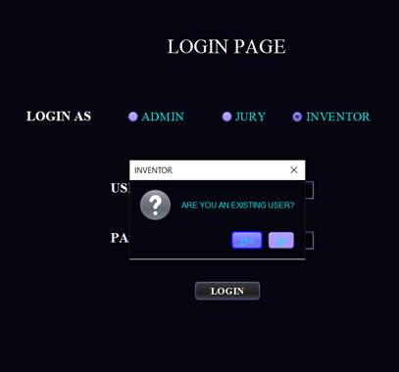
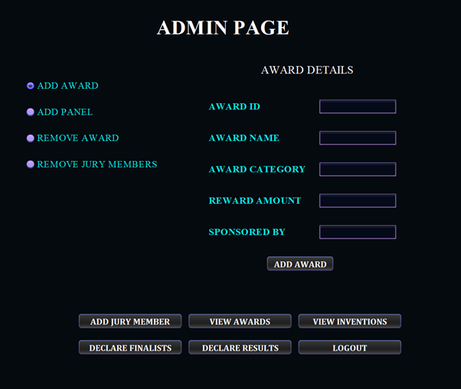

Slide 38
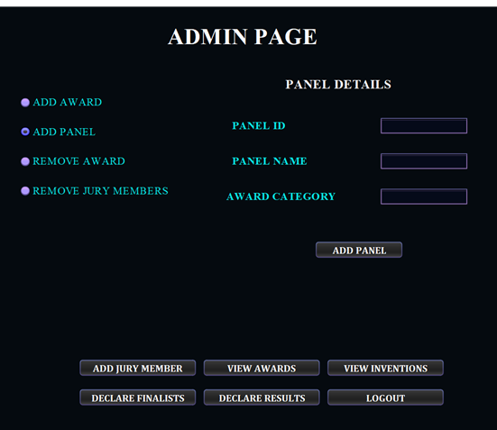
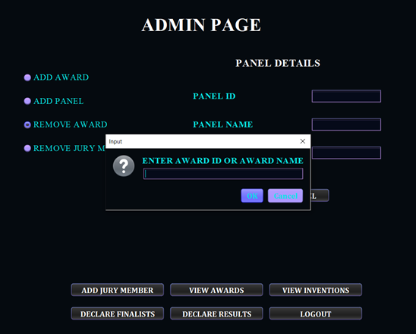

Slide 39
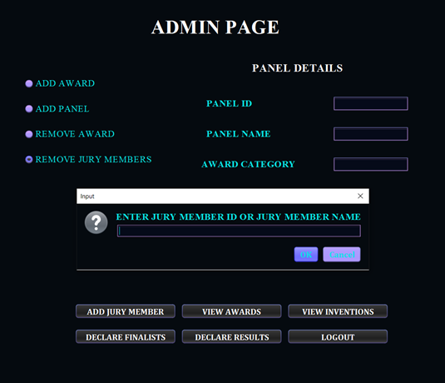
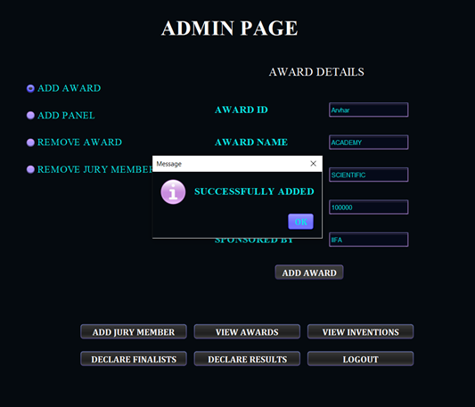

Slide 40
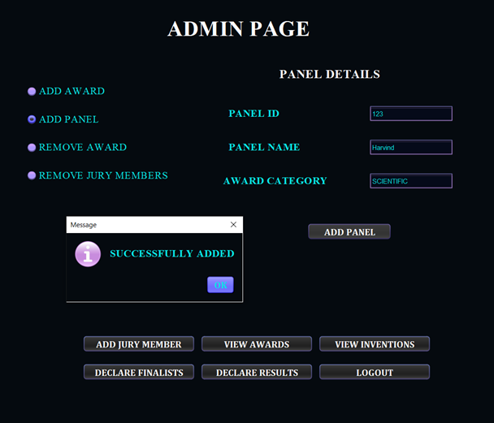

Slide 41

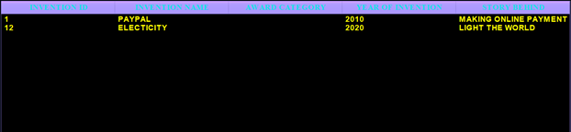

Slide 42
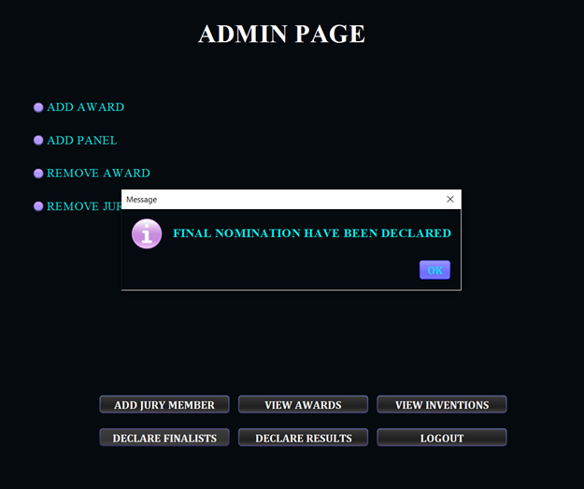
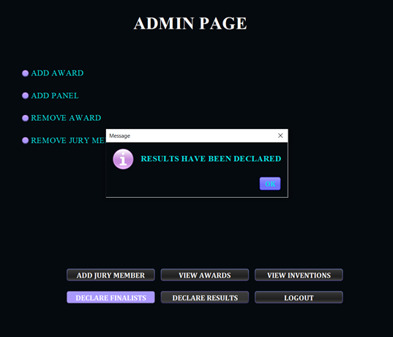

Slide 43
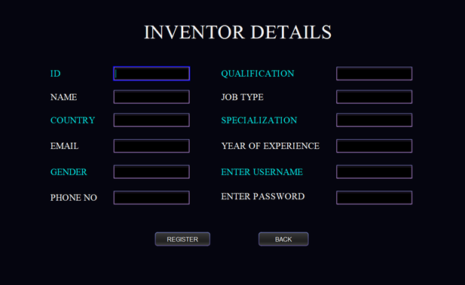

Slide 44
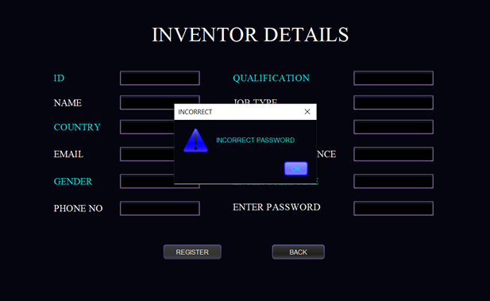
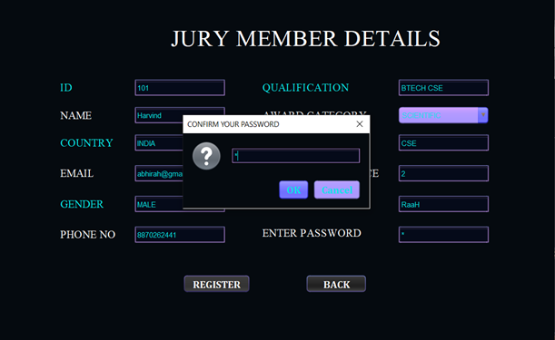

Slide 45
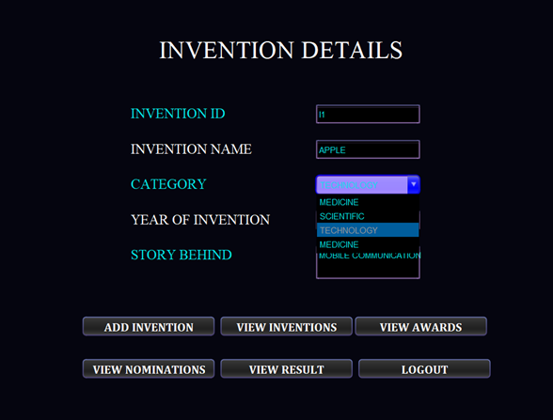

Slide 46
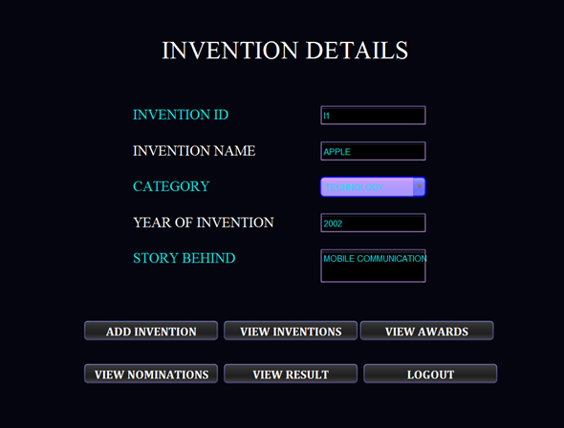

Slide 47
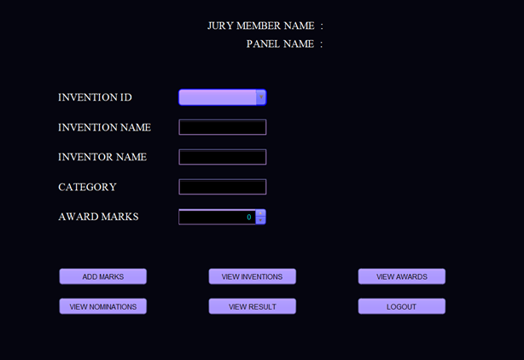

Slide 48
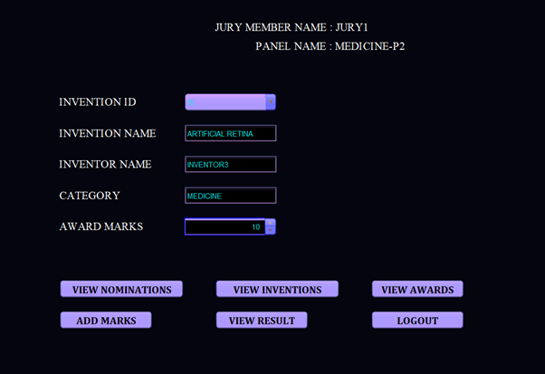

Slide 49
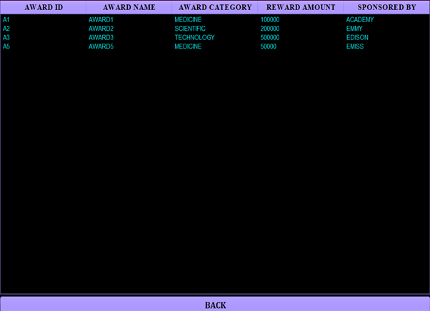

Slide 50
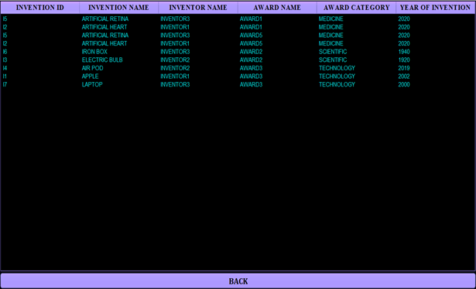

Slide 51
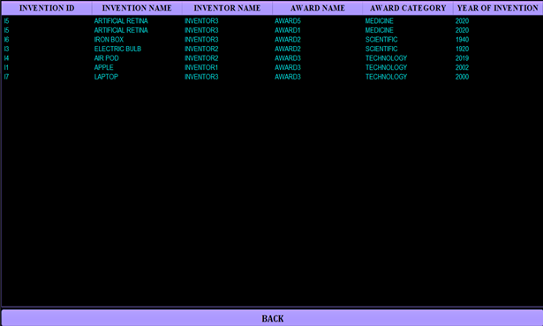

Slide 52
Thankyou

